Slide 1

upGrad
Equipment Failure for Maintenance

Slide 2

Our Team Infographic
TEAM MEMBERS
TEAM PROGRESS
RITESH KUMAR – 12018588
RAJNISH BHARTI – 12015883
RAJ PANDEY - 12018642
AMAN GAVEL – 12018431
RAJ
AMAN
Mentor : Ved Prakash Chaubey
RITESH
RAJNISH
https://github.com/rajnish1602/Equipment-Failure-on-Sensor-Data.git

Slide 3
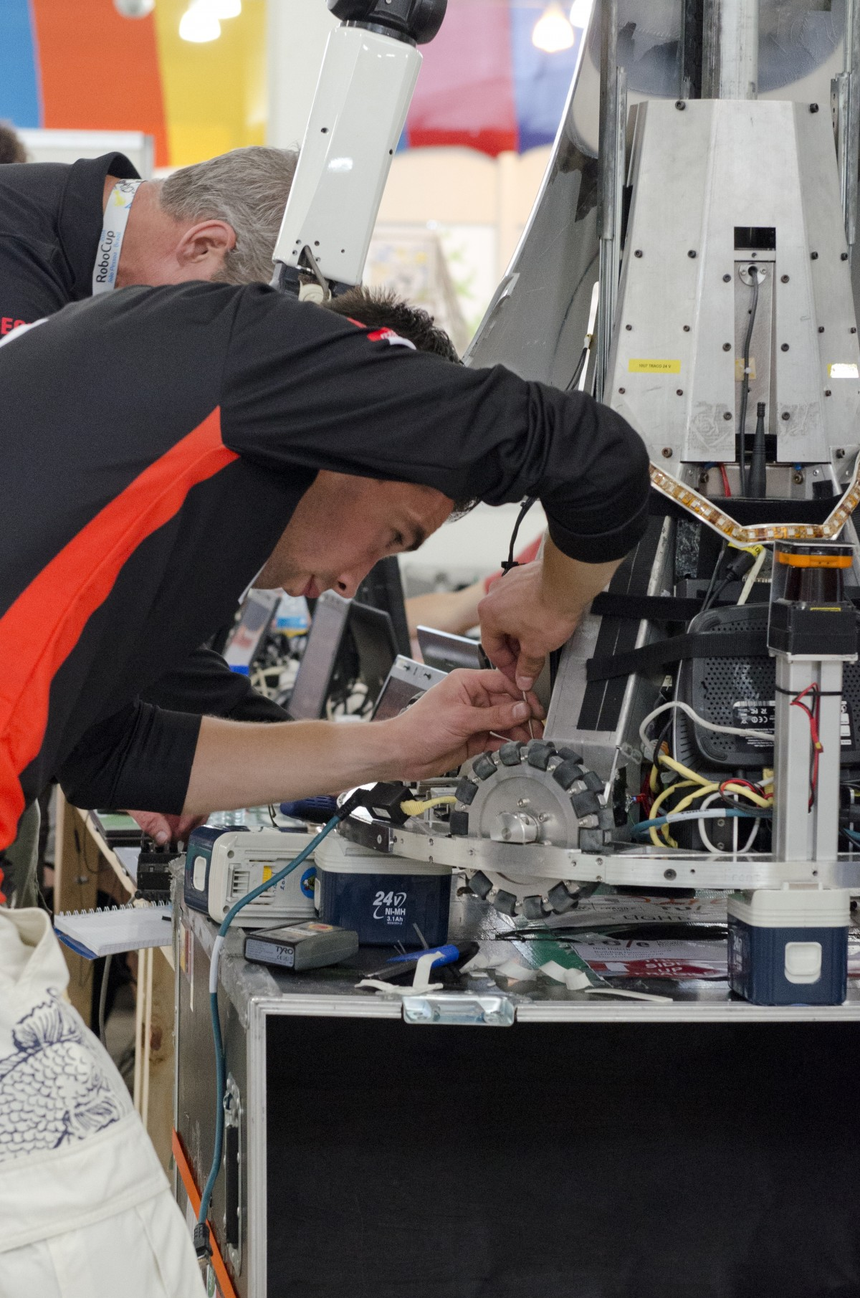
Agenda
01
INTRODUCTION
02
ABOUT PROJECT
03
DATA PREPARATION
04
DATA VISUALIZATION
05
STEPS OF EDA
06
DATA ANALYSIS
07
INSIGHTS

Slide 4
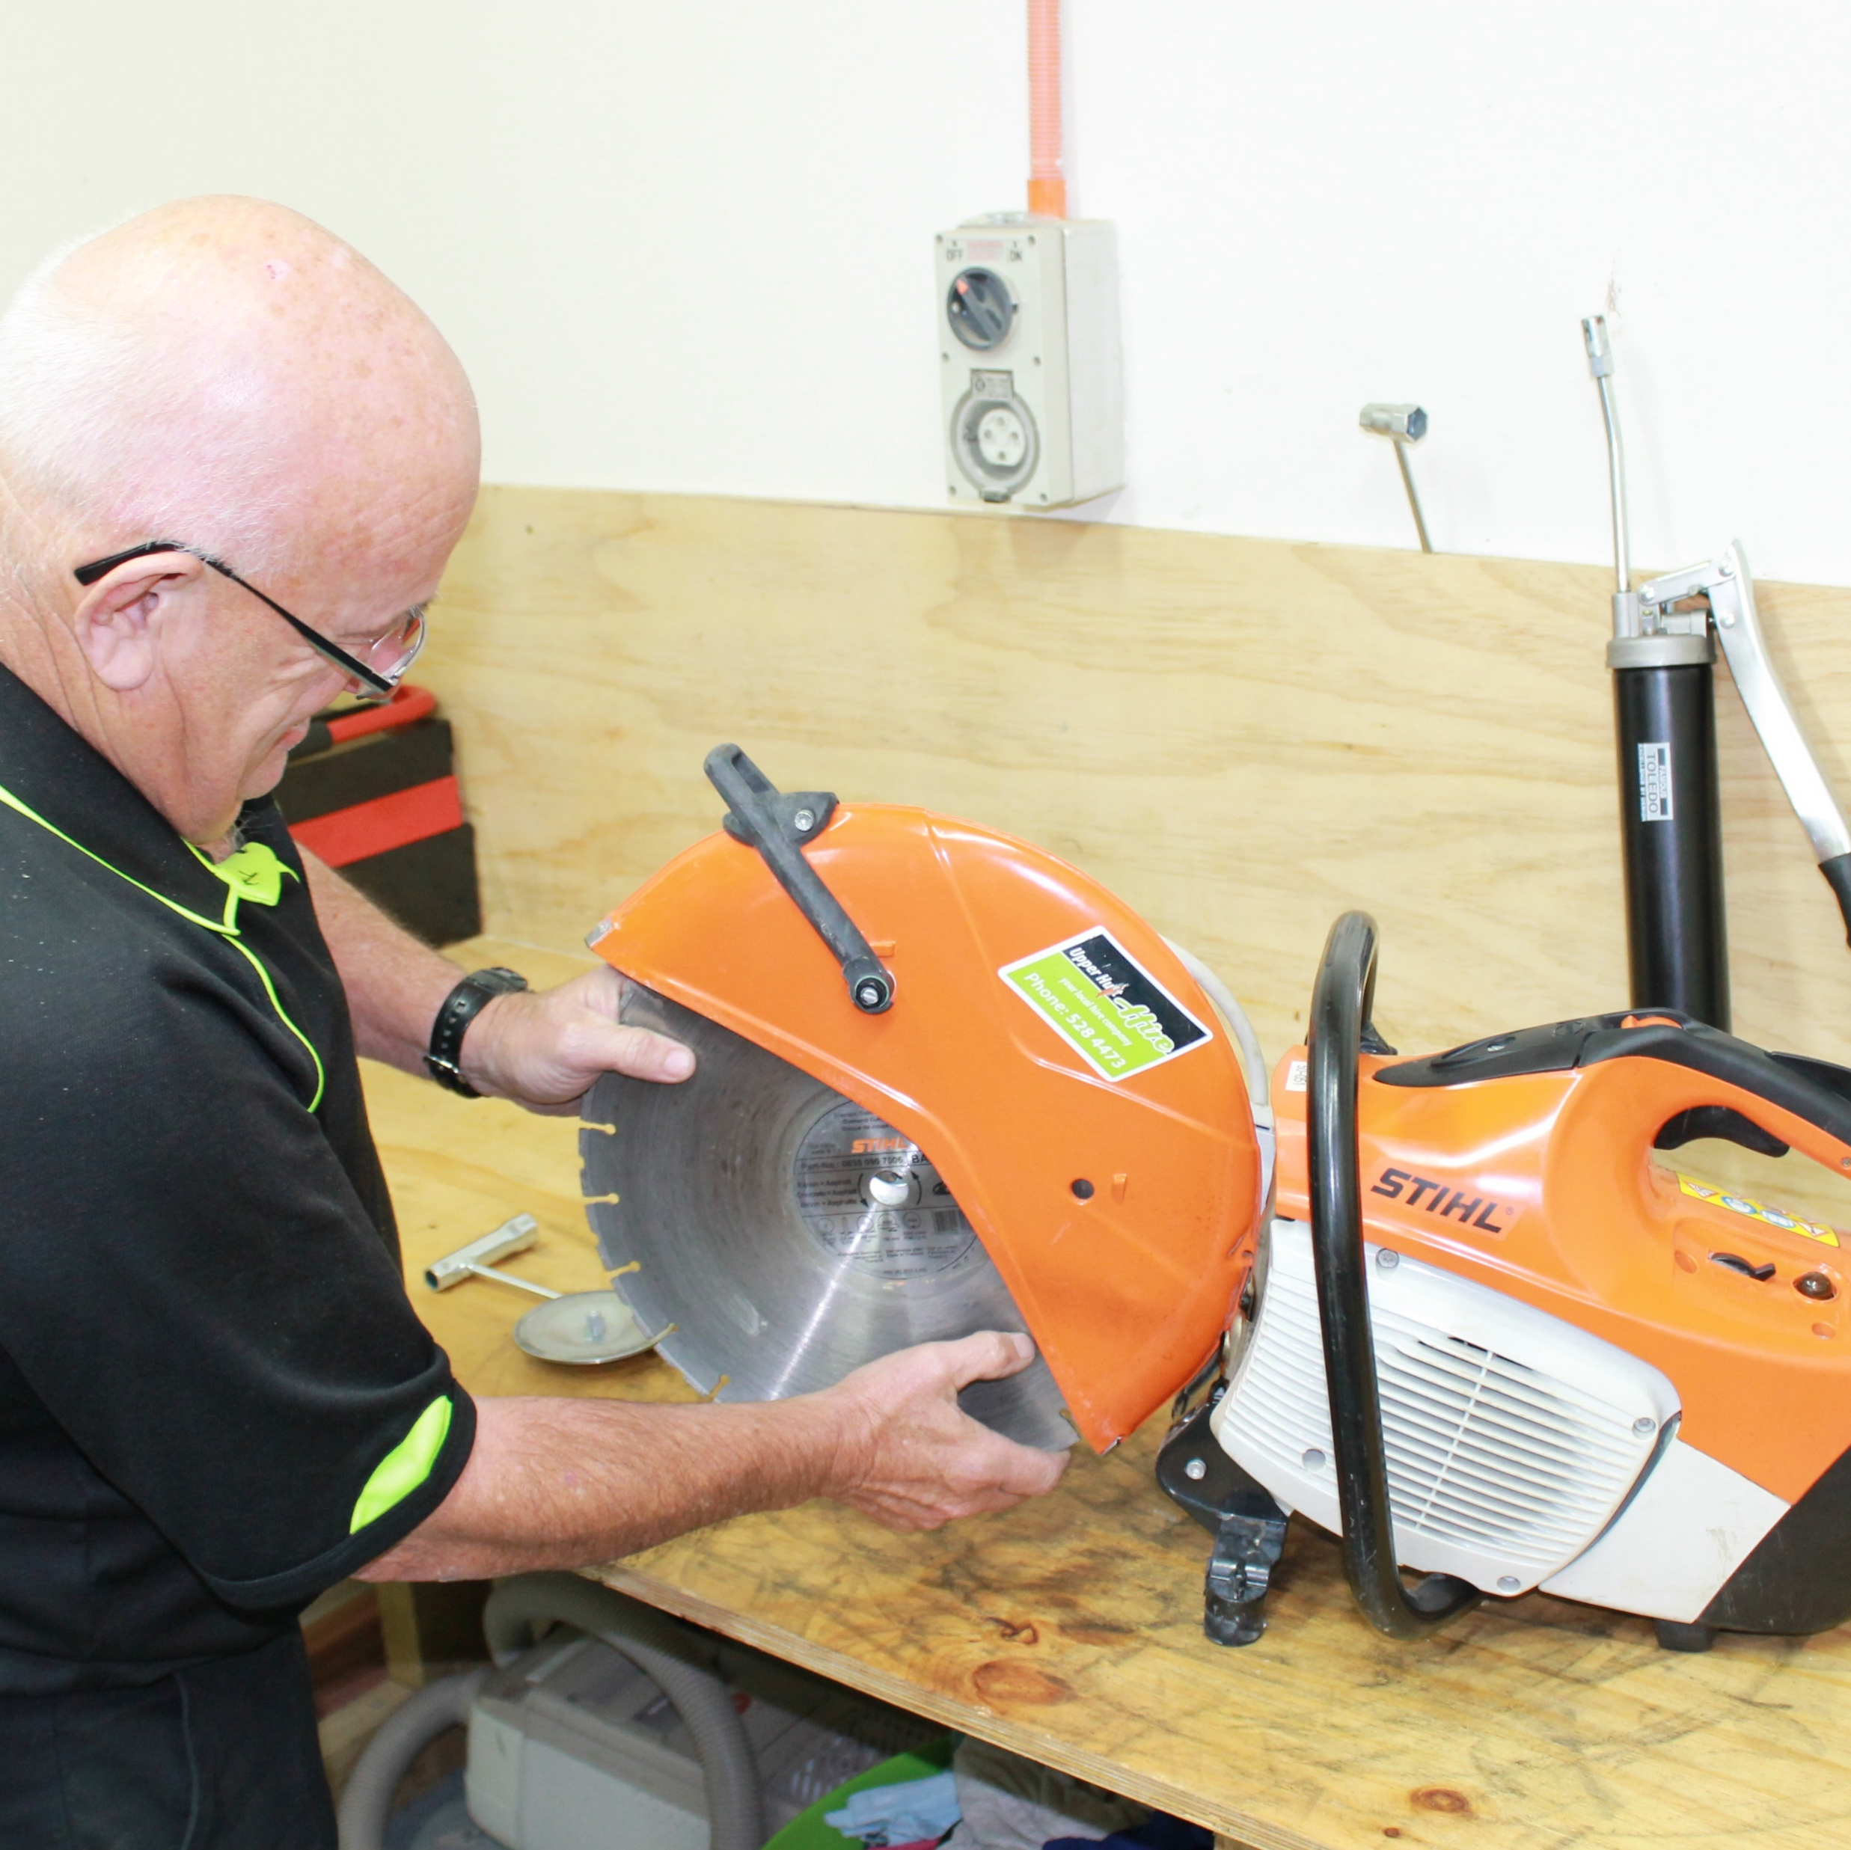
INTRODUCTION
Predictive maintenance plays a crucial role in various industries to ensure the reliability and efficiency of equipment. This paper presents a comprehensive methodology for predictive maintenance, leveraging advanced machine learning (ML) and deep learning techniques. The objective is to develop a predictive maintenance system capable of pre-emptively identifying equipment failures, thereby enabling proactive maintenance interventions. The methodology encompasses data collection, preprocessing, feature engineering, model selection, training, and deployment. Various tools and technologies such as Python programming language, TensorFlow, and cloud computing platforms are employed to enhance scalability and flexibility. The proposed framework is applicable across diverse domains, offering significant impacts such as reduced downtime, lower maintenance costs, and improved operational efficiency.

Slide 5

TRADITIONAL WAY OF MAINTENANCE
Reactive Maintenance: This strategy involves fixing equipment and systems after they have already broken. While this approach requires less staffing and maintenance training fees.
Preventive Maintenance: This approach involves performing maintenance tasks on a fixed schedule, such as replacing parts or conducting inspections, regardless of whether or not the equipment is showing signs of wear or malfunction. This can lead to unnecessary maintenance activities and wasted resources.
Lack of Real-Time Data: Traditional maintenance methods often lack real-time data monitoring, which can lead to unexpected equipment failures.
Higher Costs: Traditional maintenance methods can lead to higher costs due to unnecessary preventive maintenance and the costs associated with equipment failure.
Lack of Efficiency: Traditional maintenance methods can be less efficient as they do not utilize data to optimize maintenance schedules.

Slide 6
Why equipment failure for maintenance required ?
 | Proper training and adherence to operating procedures can help prevent this
 | Improper Operation
 | Regular maintenance is essential for optimal performance. Neglecting preventive maintenance can lead to equipment failure
 | Failure to Perform Preventive Maintenance
 | While preventive maintenance is important, too much of it can also lead to problems. Over-maintenance can result in unnecessary downtime and increased costs.
 | Too Much Preventive Maintenance
 | Continuous monitoring of equipment can help detect issues early and prevent equipment failure. Without it, problems might go unnoticed until it's too late
 | Failure to Continuously Monitor Equipment
EQUIPMENT
FAILURE
FOR
MAINTENANCE
Equipment maintenance is crucial to prevent failures and ensure smooth operations. Here are some common reasons why equipment failure occurs and why maintenance is required
Bad (or No) Reliability Culture
A strong reliability culture emphasizes the importance of regular maintenance and encourages everyone to play their part in maintaining equipment

Slide 7
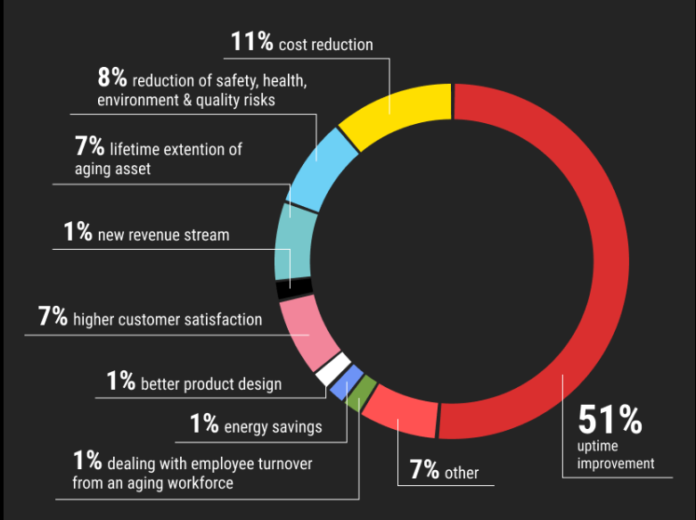
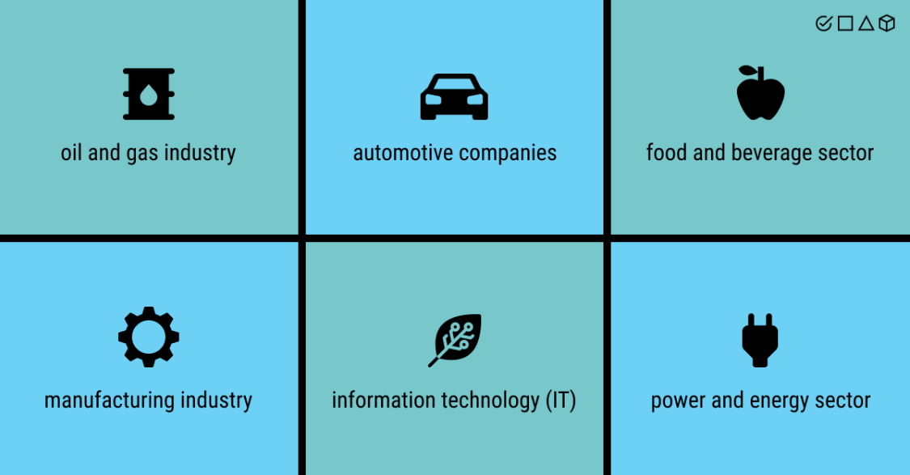
Impact of Equipment Failure Prediction
Major Impact Industries

Slide 8
DATA PREPARATION
HUGGING FACE
DATA UNDERSTANDING
DATA SOURCES
EDA
DATA
COLLECTION
Data preparation is the process of transforming raw data from multiple sources into a standardized format. This ‘preparation’ makes the data ready for use by business intelligence tools and is thus a prerequisite to analysis.
UC Irvine ML Repository
DATA CLEANING

Slide 9
EXPLORATORY DATA ANALYSIS
FEATURE ENGINEERING
DATA UNDERSTANDING
DATA CLEANING

Slide 10
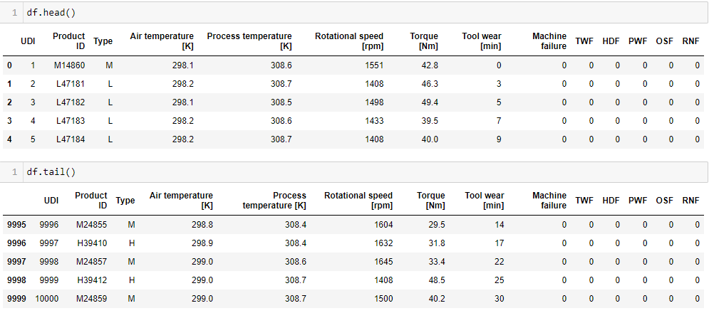
DATA UNDERSTANDING
There are 10000 rows and 14 columns
In this Data Frame, contains 1st and last five rows.
Columns Details
1. UDI: Serial no.
2. Product ID: Equipment ID
3. Type: Type of Equipment
4. Air Temperature: in K
5. Process Temperature: in K
6. Rotational Speed: Revolutions per minute
7. Torque: in Newton meter
8. Tool wear: minutes
9. Machine Failure: 0 or 1
10. MWF, HDF, PWF, OSF, RNF : MACHINE COMPONENTS

Slide 11
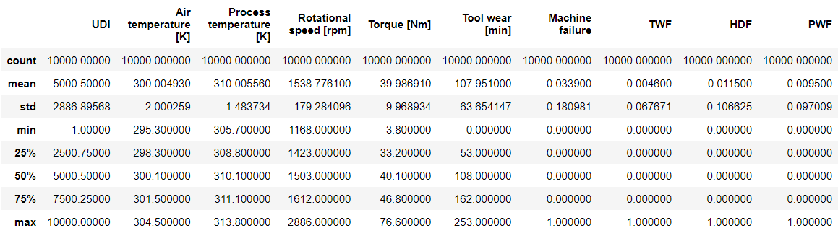
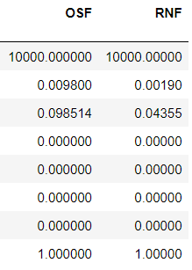
Statical Summary
Count: All columns have a count of 10,000, indicating there are no missing values.
Mean: This row represents the average value for each column.
Std: This row shows the standard deviation, which measures the amount of variation in each column.
Min: This row shows the minimum value in each column.
25%: This is the first quartile, indicating that 25% of the data in each column is below this value.
50%: This is the median, indicating that 50% of the data in each column is below this value.
75%: This is the third quartile, indicating that 75% of the data in each column is below this value.
Max: This row shows the maximum value in each column.

Slide 12
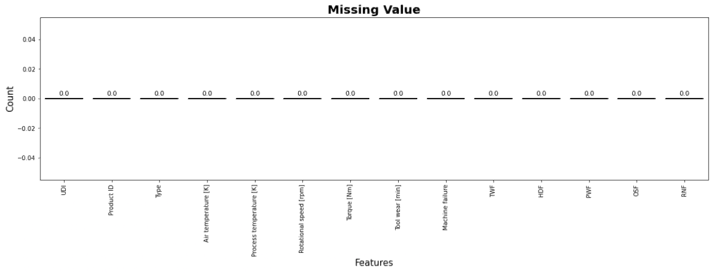
Missing Values
Summary
Here, is the brief about the graph
- As there is no missing value in any columns.
- So further we analyse each columns by univariant, bivariant and multivariant, and data transformation

Slide 13
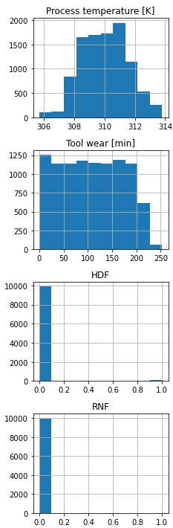
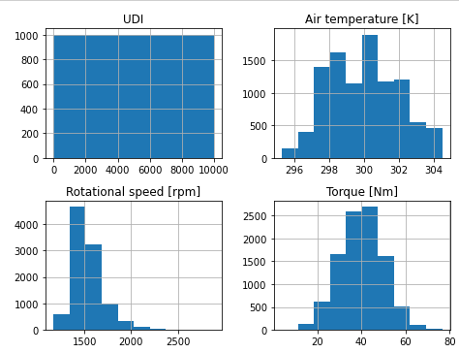
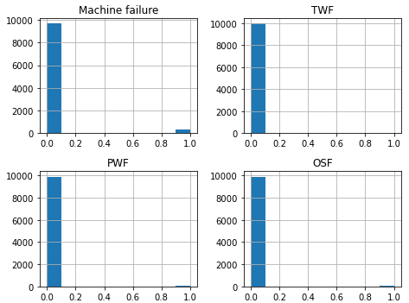
Distribution Plot
Here, All the graph represent distribution of data in each columns

Slide 14
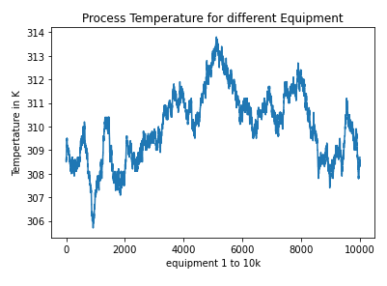
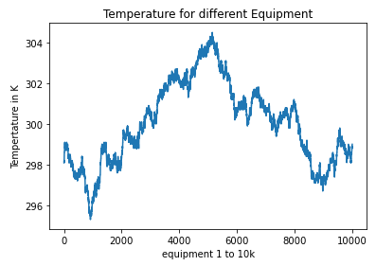
Line Graph of Air Temperature & Process Temperature Columns

Slide 15
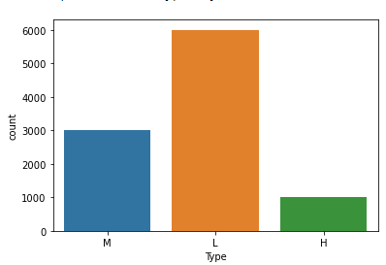
In this graph, Equipment are of three type M,L,H
- M Type: 3000 equipment's
- L Type: 6000 equipment's
- H Type: 1000 equipment’s
Further, we can split this columns to into 3 parts M_type,
L_type, H_type

Slide 16
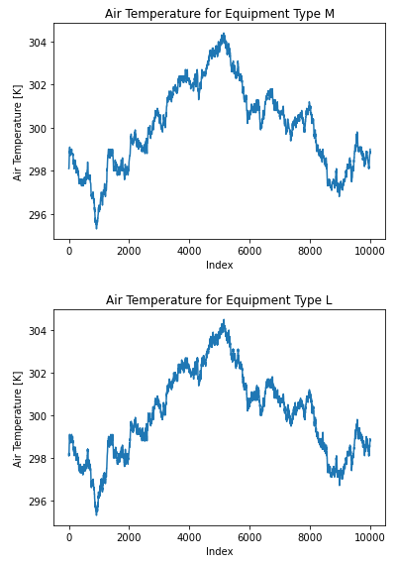
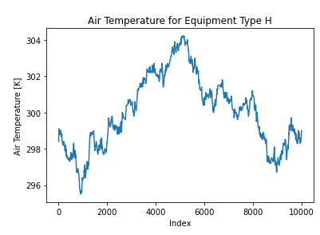
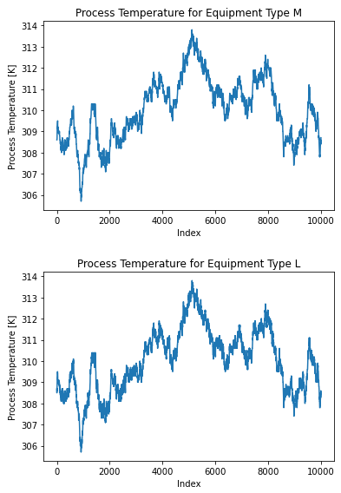
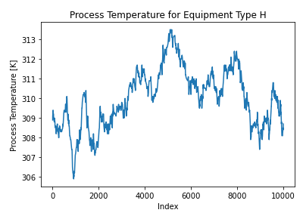
Bivariant and Multivariant Analysis

Slide 17
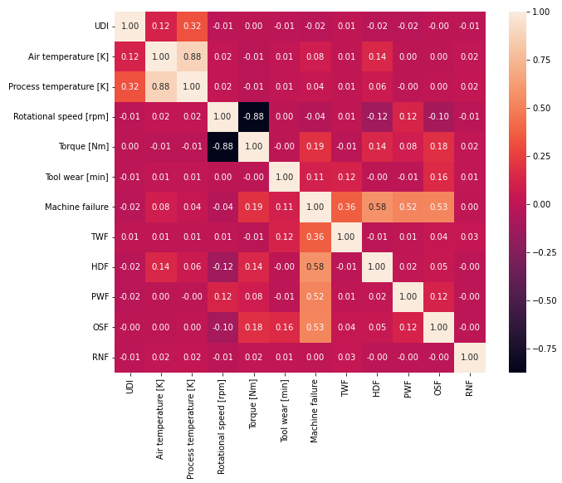
Checking Co-relation
Coefficients
Parameters: The parameters include UDI, Air temperature [K], Process temperature [K], Rotational speed [rpm], Torque [Nm], Tool wear [min], Machine failure, TWF, HDF, PWF, OSF, and RNF.
Color Gradient: The cells are colored from dark purple to white to dark red indicating the range of correlation from -1 through 0 to 1 respectively. Dark red cells with a value of 1 indicate a perfect positive correlation.
Interpretation: Most correlations appear weak as indicated by colors close to white and values close to zero; however, there are stronger correlations visible such as between Air temperature and Process temperature.

Slide 18
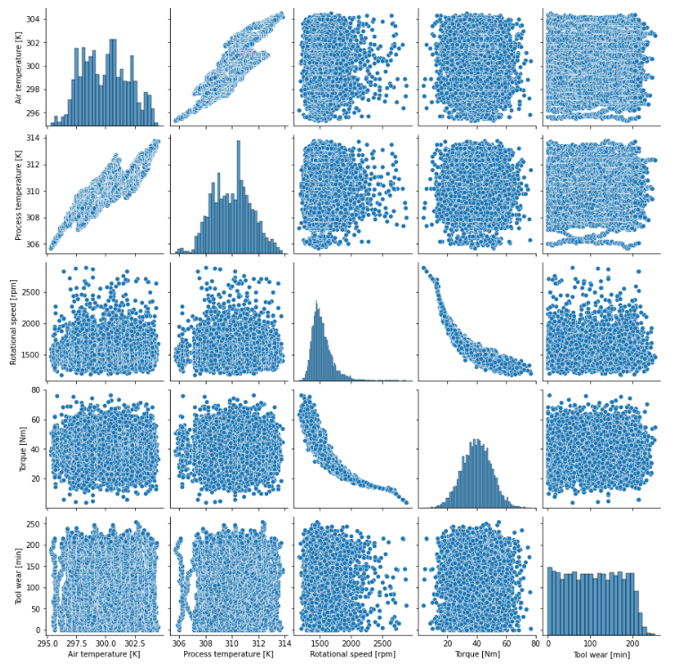
Matrix of Pair plot that visualize the relationships between different variables such as Air Temperature, Process Temperature, Rotational Speed, Torque, and Tool Wear. Here’s a summary for your PowerPoint presentation:
Variable Distributions: The histograms on the diagonal show the distribution of each variable. For instance, Air Temperature appears to have a normal distribution, while Tool Wear shows an increasing trend.
Variable Relationships: The scatter plots off the diagonal illustrate how two variables relate to each other. For example, there’s a plot comparing Process Temperature against Air Temperature.
Data Representation: Data points are depicted as blue dots in scatter plots and blue bars in histograms, providing a clear visual representation of the data.

Slide 19
Equipment Failure For Maintenance
Thank You

